Slide 1
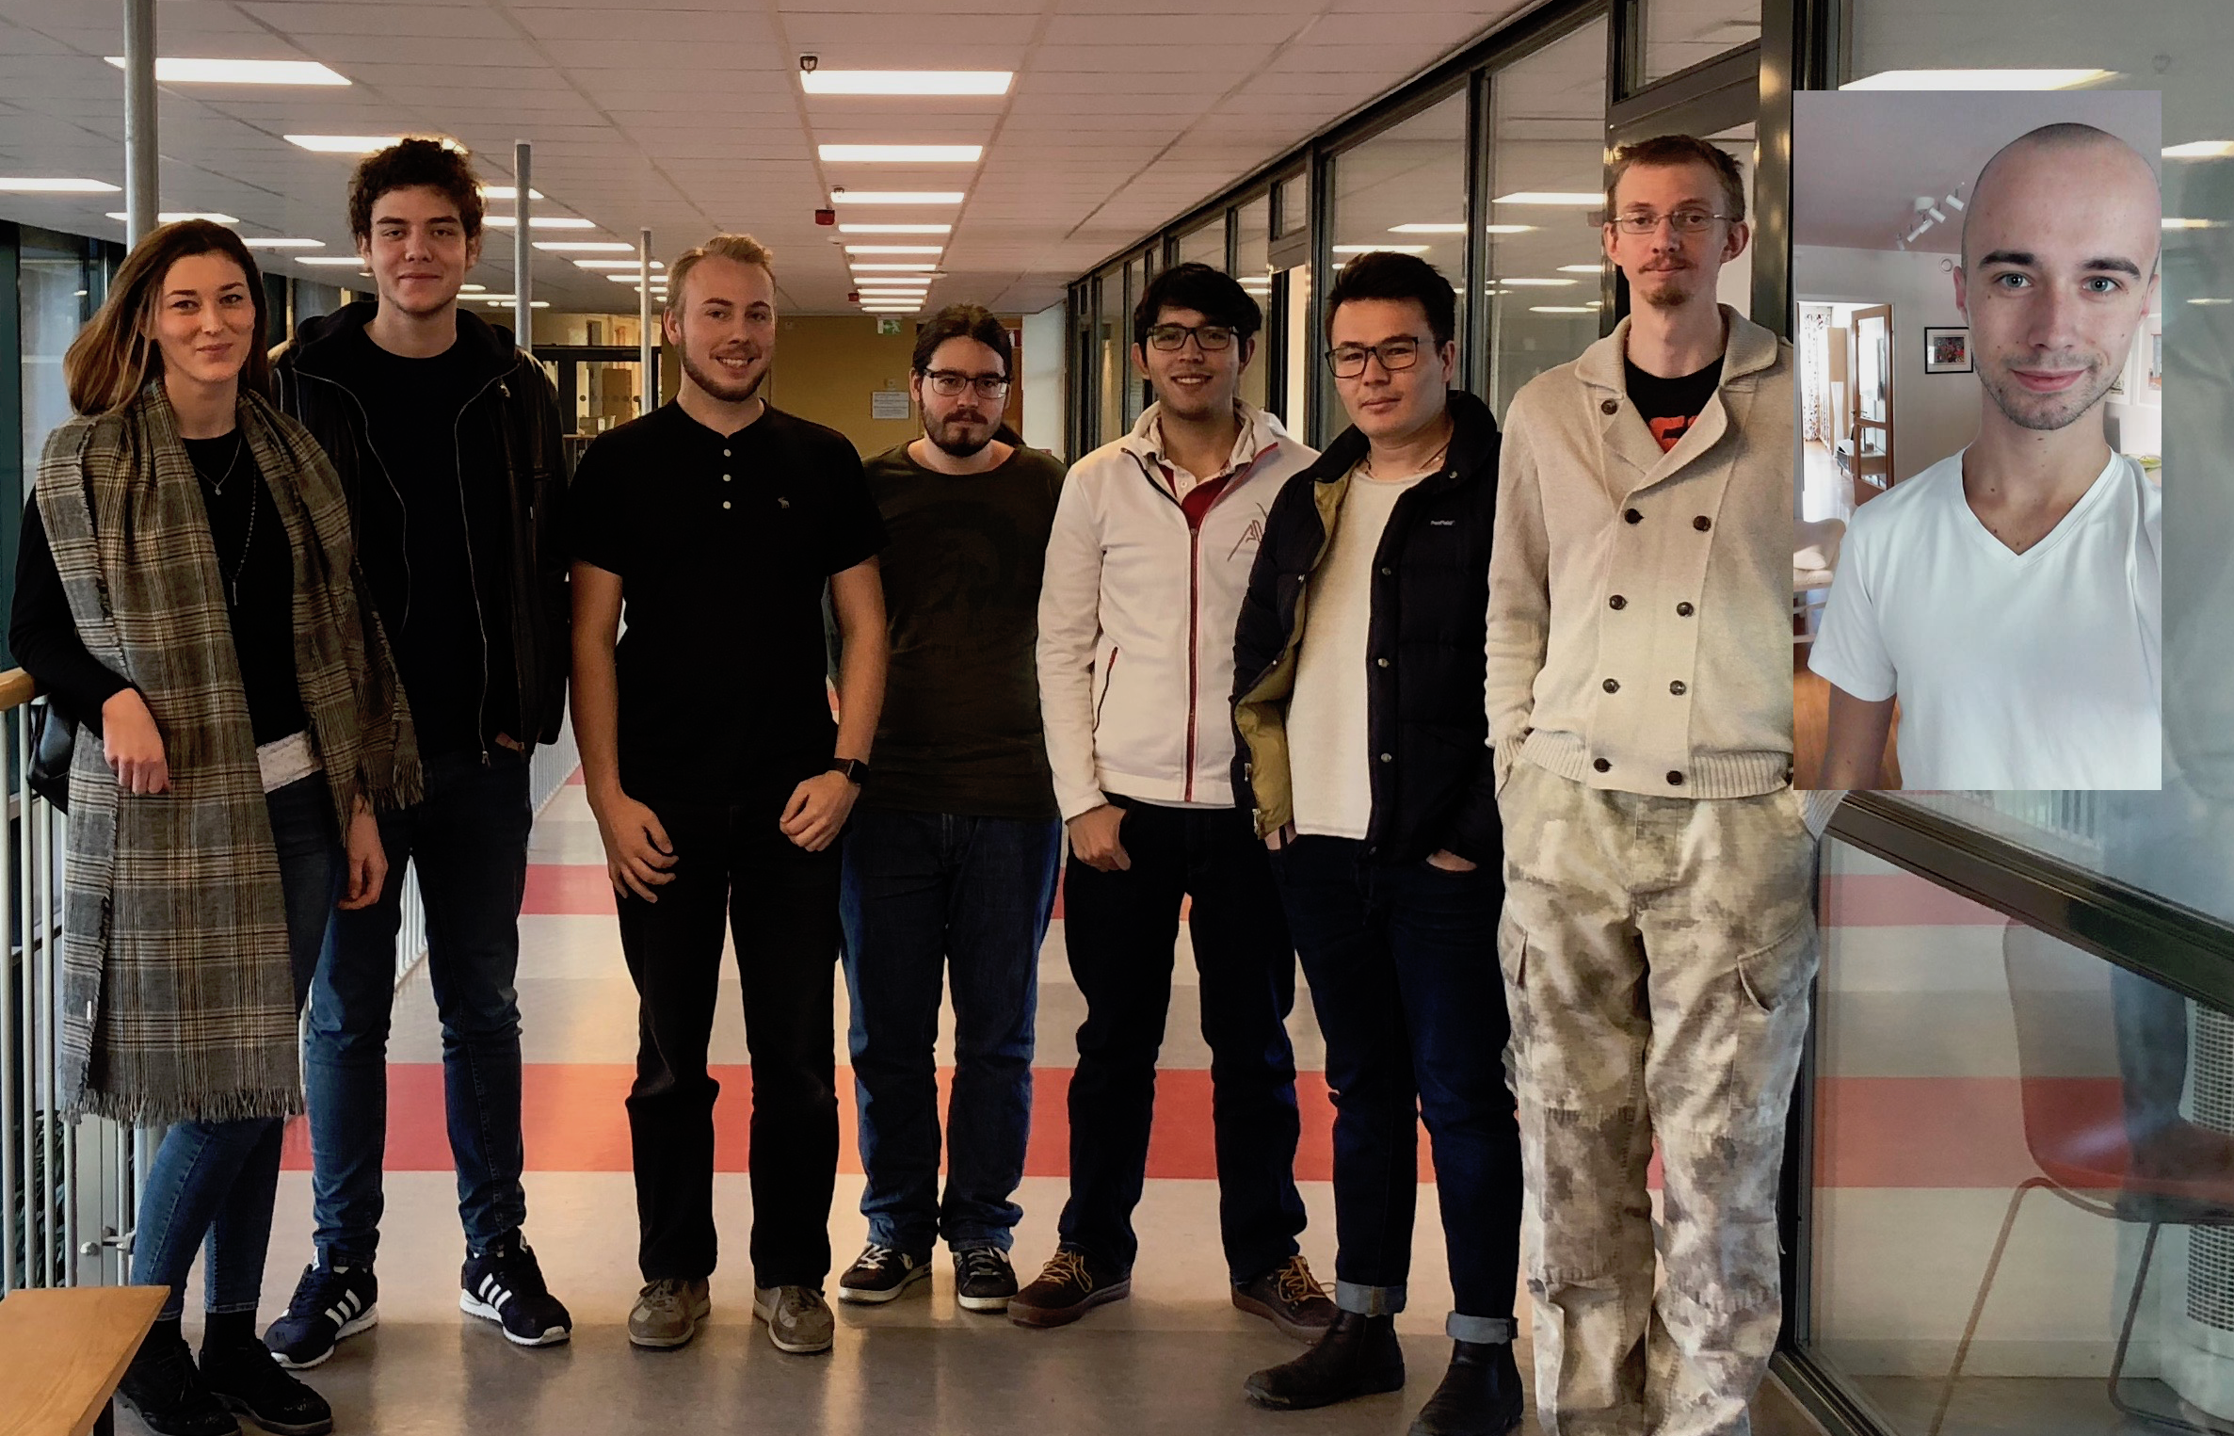
Group 1
INTERACTIVE JOINT KANBAN BOARD FOR ABB PORTS

Slide 2
Previous Week
Worked on the Project Plan (Google Docs)
Wrote the first draft of: High level description of the domain, High level description of desired functionality, Description of existing systems, List additional functional and non functional tasks
Access to TeamForge Software - in progress
Created Use Case Diagram
Made plans for the week 2

Slide 3
This Week
Continue working on the Project Plan
Write the first draft of: Introduction, Initial Project Backlog, Deliverables with deadlines and milestones, Quality assurance
Make a draft sketch of the User Interface
Create Gantt Chart
Create the first draft of Requirements Document
Schedule second meeting with client
Make plans for the week 3

Slide 4
Obstacles & Issues
TeamForge Trial
Notes:
1st point: still now access to teamforge. in worst case could the school pay? Or what should we do?

Slide 5
Hours Worked
André: 5-6 hours (sick first two days)
Anton: 14 hours
Amer: 13 hours
Džana: 14 hours
Jawid: 13 hours
Kevin: 13 hours
Robert: 16 hours
Noah: 15 hours
Total: 103 hours
Notes:
Since this is the first week these hours are both last week's work and total for the entire project.

Slide 6
Questions
Completion of Requirements
How specific should the worked hours be?
What counts as an hour worked?
Notes:
1st point: what happens if we don’t complete all requirements?
2nd point: do they want to know what we spent time on, or is just a number fine?
3rd point: for example: is time spent researching, doing tutorials and such supposed to count even if it’s not on the kanban board?

